Slide 1
Create your own one-page RPG
Nina NAVAZIO | Deepti Vaidyanathan
Thanks to: William ASSAF
Checklist
Grab worksheets (should be 2 pages)
  Or go to: tinyurl.com/CreateYourOwnOnePageRPG > Worksheets
Answer at your table: If your favorite game existed, what would it be like?
Notes:
<deepti> Welcome to Create your own one-page RPG, a design thinking workshop. My name is Deepti Vaidyanathan, I’m a software engineer in Azure Compute, and I’ve been playing RPGs since college haven’t really stopped since! I’m joined by my Cohost, Nina, and our wonderful friend William who helped us create this workshop! Nina?...
Awesome, we’re ready to really get started now. Going over the checklist, please make sure that you have the worksheets you need, there should be two pieces of paper, and they should say Part 1, 2, and 3 on them. If you don’t have a physical copy, you can follow along with a copy from our Github at tinyurl.com/CreateYourOwnOnePageRPG > Worksheets.

Slide 2
Overview
By the end of this workshop, you will have filled out both worksheets, or have plans to fill it all out and be inspired to continue creating and playing RPGs.
PROLOGUE Why make a tabletop role-playing game?
Part 1 Empathize + define: foundations (+ workshop time)
Part 2 Ideate: turn actions into gameplay (+ workshop time)
Part 3 Prototype: writing THE rules (+ workshop time)
Finale This is all design thinking!
Epilogue Next steps for your RPG & Q&A
Notes:
<deepti> So just to set expectations, by the end of this workshop you'll have filled out both pages of the worksheet (or at least have an idea of how to fill it out), and hopefully will be inspired to continue to work on your RPGs.
We'll take you through how to fill out each part step-by-step and give you about 10-15 minutes of workshop time to fill out your own sheets, but feel free to skip ahead or write things down whenever inspiration strikes.
At the end, we'll discuss how this all relates back to design thinking and provide next steps if you want to continue to develop your RPG.

Slide 3
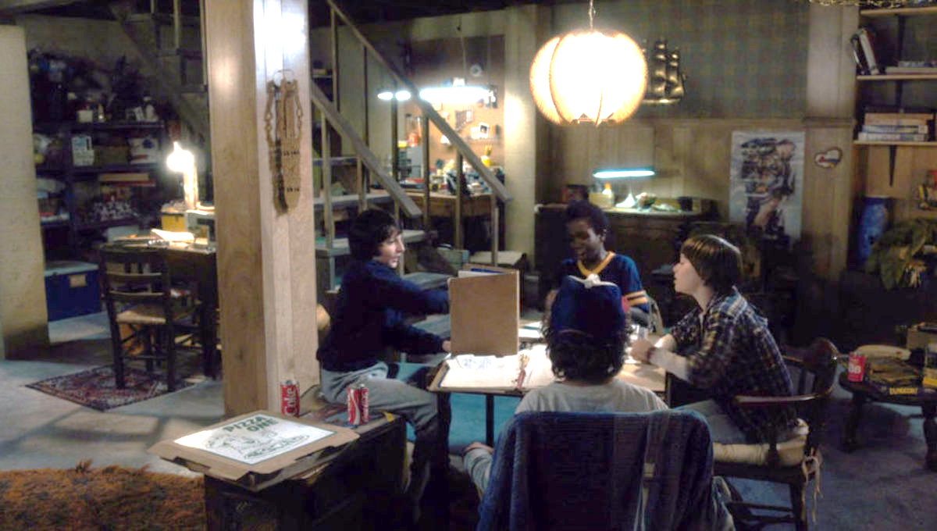
What is a tabletop role-playing game (TTRPG)?
CREATE YOUR OWN RPG
Stranger Things (season 1, episode 1, Netflix)
Notes:
<nina>
So, what is a TTRPG? Let’s look at this scene from Stranger Things, here you can see the two roles at the table: the Players,
<click>
and the Main Storyteller
<click>
(also known as the Game Master or Dungeon Master or Main Storyteller, the terminology differs and is up to you.)
Everyone here is playing the game, but the Main Storyteller knows a lot more than the other players about the events that will be unfolding—they’ve probably prepared a series of scenes, quests, and enemies for the player to experience and meet.
Your games today could be similar or completely different– like having no Main Storyteller at all. It’s all up to you. But ultimately, we’re all here to tell a story together.

Slide 4
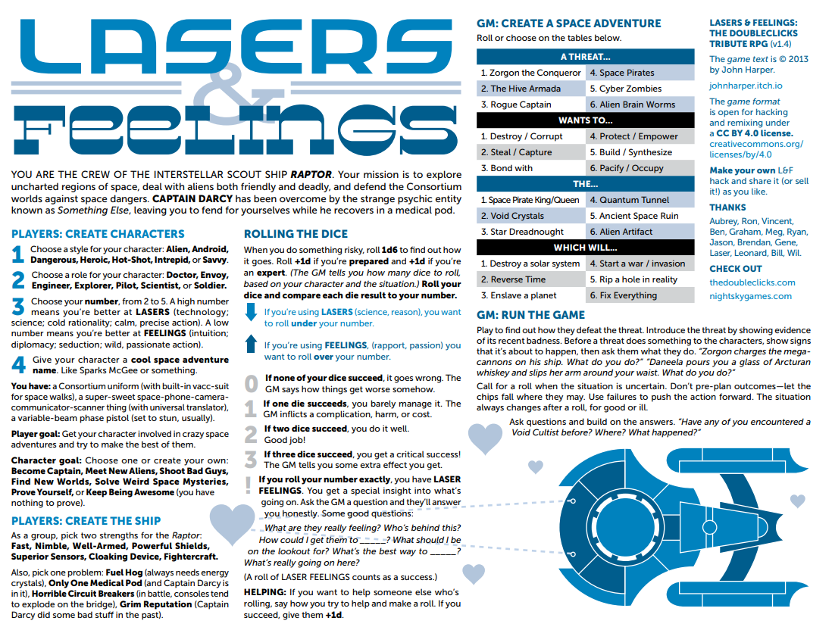
What is a one-page TTRPG?
Lasers and Feelings
onesevendesign.com/laserfeelings
Notes:
<nina>
OK So our friends in Stranger Things were playing with plenty of books and papers detailing the rules. But a One-page RPG, like what we’re making today, fits literally on one page. Let’s look at the one-page RPG <click> Lasers and Feelings for example.
On this dense but singular page, there are rules for <click> character creation, which players only have one stat to worry about, <click>
instructions on setting up the team’s silly Star Trek parody ship, <click>
a loose rule about making decisions, <click>
and some fun optional randomization for the story. <click>
There’s somehow even space for suggestions for the Game Master and a drawing of a space ship with some links.
This is all GMs need—and all players need– to play this game. This is what we aspire to: a page with everything for your game so it’s easy to share, learn, and play. By the end of this workshop, you should all leave with a solid foundation for your own one page RPG.

Slide 5
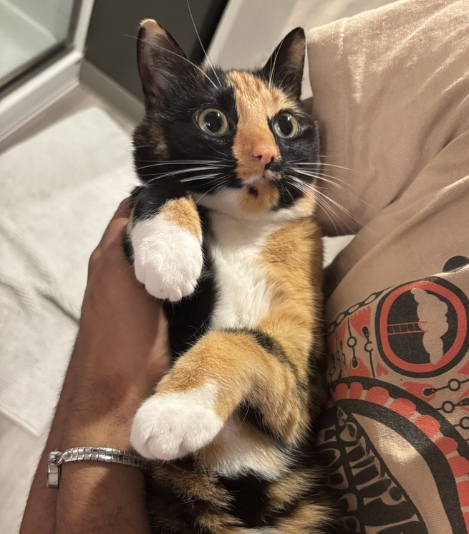
Empathize + Define: Game Foundations
Topic: Brainstorm and select one topic for your RPG
  What do you want the game to look like to the player(s)?
Inspirations: What can you borrow from media/games related to this topic?
  What other games have you played and what were their rules?
Theme: How can you build "game feel" / vibes?
What are some actions that people do that're related to your topic?
  What do players do a lot? How does the world change the player?
  Game mechanics/rules will determine the outcome of actions
My cat & inspiration for my game, Figueroth
Notes:
Deepti
So now that we have a bit of background, we can start making our RPGs by empathizing with our game's potential players and defining aspects of our game based on what we want our players to experience.
<CLICK> The first step is to brainstorm and research some general topics you could turn into a game. They can be based on anything, like your favorite movie or TV show, personal experiences like road tripping, or even a random Wikipedia article! Once you have a few ideas, pick your favorite topic that you’ll base your game on. For this presentation, we'll be running through the example with <CLICK> Cats
Once you have a topic, <CLICK> you should think about what other external media you could use to inspire elements of your game. You can research existing references that are related to your topic, games that had engaging rules or mechanics, or even draw from your personal experience with your topic.
With your inspirations <CLICK> you can use them to generate Theme words to describe the vibes of your game. How would you want a player to describe the world of your game? What sort of creatures or things exist in your inspirations, and could any of them be in your game’s world?
As you write down these descriptors, think about the ways you could illustrate your game’s themes to your players. If the game is supposed to be scary, how can you raise the stakes for the players? If it’s a silly game, how can players get silly?
If I were making my Cat RPG, for example, I'd want the game to have a chaotic and silly vibe, so I could say that cats in my game can be vocal, clumsy, spicy, etc.
<CLICK> Once you have a sense of your game’s themes, you can start writing down common “actions” that characters could do to interact with the world or actions that could happen to them. Look back at your Inspirations and Themes and see if there’s any character-world interactions that happen frequently. What should players expect to be able to do or encounter as they play your game so that they feel the themes you wrote down earlier?
These actions are going to help us make our games’ rules and mechanics because in your game, the outcome of these actions will likely be determined by the game mechanics you create. In the Cat RPG, for example, players might expect to be able to explore small spaces, hide from scary noises, interact with other animals/humans, etc.
With these actions in mind, I’d want to think about how the players can succeed or fail and how I can make these actions fit the chaotic theme in gameplay (which we’ll go more into detail later).
(Slide gives instructions and tips on how to fill out Part 1 of the worksheet, and what to think about as they fill it out)
Deleted content:
What is unique about those "actions"?
How could you portray that "unique-ness" into a game, like a "game mechanic"?
How can those "actions" be illustrated in gameplay, to help players really experience what it’s like to do those things?
These actions are going to serve as the basis for our game’s mechanics which will help us determine the outcome of , so as you’re writing them down start thinking about ways that they can be illustrated in gameplay
fleshing out what our game should look like from the players' perspective.

Slide 6
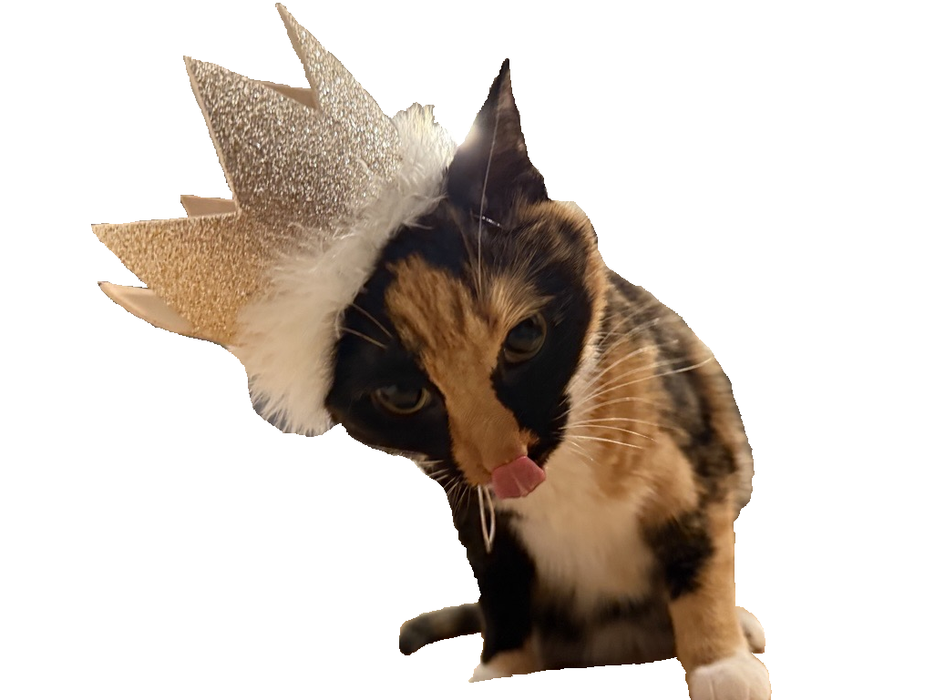
Workshop: empathize & define
PART 1
10 MINUTES
FIELD | DESCRIPTION | EXAMPLES
Topic | What your game will be about | Genres, movies/TV shows, video games, personal experiences, … (Cats)
Inspirations | Media that’s related to your topic and games + their mechanics that you’ve liked | For “Cats,” video game Stray, my cat Fig, Dungeons and Dragons, Chutes and Ladders, …
Themes | Descriptors for what your players would see/feel in your world | For “Cats,” chaotic, silly, lots of cats, maybe other animals, running around a city, …
Actions | Ways your players can interact with the world and vice versa | For “Cats,” players could explore small spaces, knock things over, … Players could also encounter scary dogs that chase them, animal control, other humans that try to pet them, etc.
Feel free to move on to other sections as you brainstorm
Nothing needs to be perfect!
Worksheets & slides here: tinyurl.com/CreateYourOwnOnePageRPG
Notes:
Deepti
So now we’ll give you about 10 minutes to fill out Part 1 of the worksheet so that you can figure out your topic and fill out your Inspirations, Themes, and Actions.
The goal is to get as many ideas written down as possible, so nothing needs to be perfect. If you need some inspiration we've provided examples of what the Cat RPG would look like in this part and you can also go to the tinyurl below to see the fully filled out worksheet example. Feel free to let us know if you have any questions!
This workshop time will be about 10 minutes to fill out Part 1 of the worksheet,
the goal of this section is to brainstorm without filter so that they have plenty of ideas to choose from in the next sections
We'll also provide an example worksheet that we've filled out to give them a sense of what it might look like

Slide 7
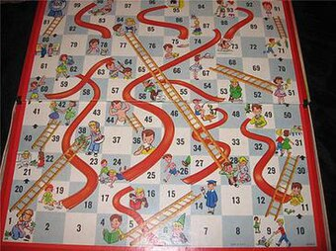


Ideate: turn actions into gameplay
Mechanics are rules and parts of a game “that govern and guide the player's actions, as well as the game's response to them.” (Wikipedia)
What backgrounds can players have to make them feel special?
  Customization is key (within reason)
  Focus on attributes players can pick that help build a backstory
Snakes and ladders - Wikipedia
Notes:
<nina>
You’ve brainstormed some actions, now let’s turn those into gameplay.
The core of any RPG, or any game really, is it’s “mechanics”. <click> The “Mechanics” of a game are the rules and parts of a game that govern and guide the player’s actions, and also how the game responds to those actions.
When players make a decision, mechanics help determine the outcome. For example, in the simple board game Snakes and Ladders, there’s only one decision for players to make, without a choice: roll the dice. Since the goal is to get to the top of the board, the only way to do so is by rolling and moving that many spaces. But the mechanics of the snakes and ladders determines how that action goes–if you roll a 4, <click> then you go up the board, to simulate climbing a ladder, from space number 4 to space number 14.
On your next turn, if you roll a two, <click> you’ll slide right down the snake to space number 6. In this way, Snakes and Ladders pretends you’re really climbing and sliding, even if you’re playing on a flat board.
But this is a relatively simple game. How could we level this up into an RPG? Currently in the game snakes and ladders, every player is exactly the same. Rolling the same dice, moving along the board the same. But imagine that you could create your own character for Snakes and ladders-- <click> we could consider what might make players feel special. And how can those quirks impact the mechanic of climbing ladders and sliding down snakes?
Maybe a character has a background in climbing ladders, so they actually get to climb one extra row--but they’ll also slide down any slides they land on, even if it’s midway through the slide. Maybe another character is particularly sticky, and thus resistant to slides– maybe they only slide half the distance of the slide, but they can also only climb half the distance of the ladder.
These choices not only help people build the backstories of their characters and interact with the gameworld in interesting ways, but they also directly impact the mechanics of the game. With just a simple change of customization for players, we can make the simple game of climbing and sliding into an epic storytelling game about a party of heroes trying to withstand the trials and tribulations of a cursed forest full of.. Snakes and ladders.

Slide 8

Actions → Mechanics
Fighting
Swinging a sword
Casting a spell
Throwing your fists
Actions
Important factors swinging a sword
Strength
Type of weapon
Enemy armor
Mechanics
Attributes
Weapon stats
Armor class
Notes:
<nina>
Soon you’ll get 15 minutes to work on turning your own actions into mechanics. In order to do that, take a look at your actions. What is an action that needs an outcome, and can have some randomness?
Let’s take a look at Dungeons and Dragons 5e. One of the main actions you can do is fight. What are all the things that go into fighting? <click> What are the actions? <click>
Well, for starters you might be swinging a sword, casting a spell, or throwing your fists. Let’s pick swinging a sword.
DnD 5e is very character-focused, emphasizing leveling up characters and their skills. So to swing a sword, you’d need to know <click> the things impacting that action that are relevant to your game. <click> So how strong are you? What type of weapon are you swinging? And how strong is the enemy’s armor?
Each of these things contributes to <click> the mechanic of fighting– <click> and in D&D 5e they’re known as attributes, weapon stats, and armor class respectively. This is just one part of the larger system of D&D 5e—you can see how work like this scales into massive RPGs and huge tomes of books, which is what DnD 5e aims to be.
But for today, we’re looking to write just a one page RPG. So a one-page RPG variant wouldn’t be so detailed. Maybe you’re just focused a character’s strength, or maybe it’s an RPG all about weapons so that would get the mechanic focus.

Slide 9
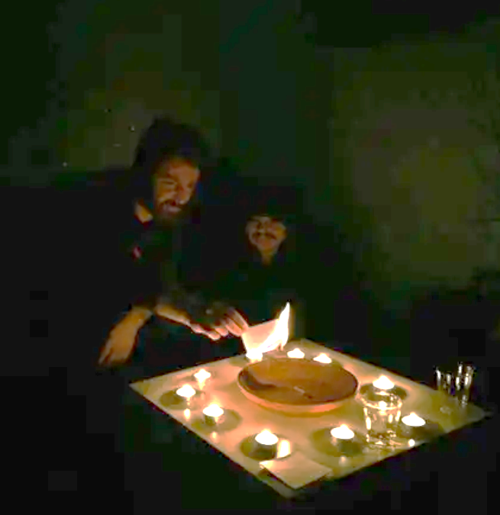
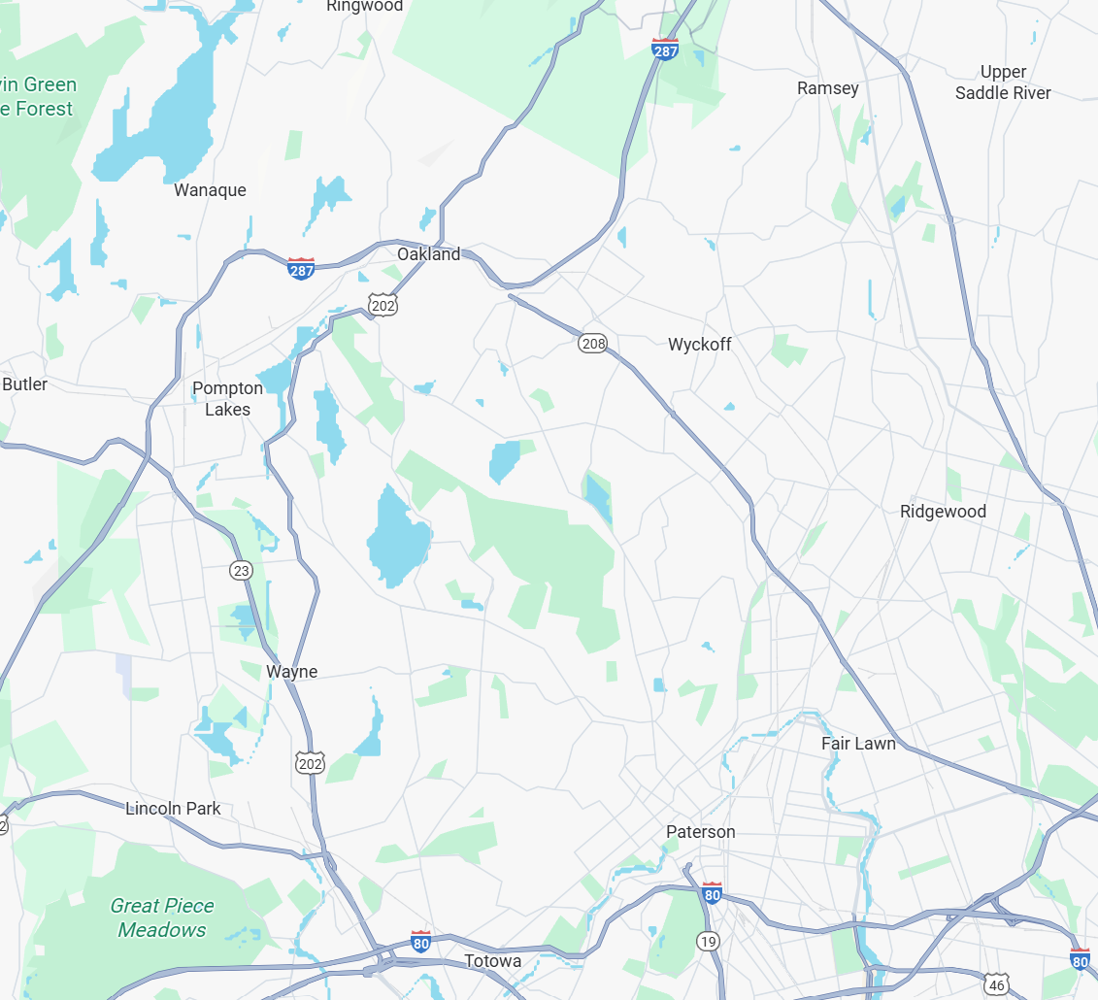
Tools of chance
Is there randomness involved?
What information helps determine the outcome?
Ten Candles — Cavalry Games
Notes:
<nina> So when you’re considering the actions you want to turn into a mechanic, ask yourself: <click>
What information helps determine the outcome? and
Is there randomness involved?
This is where we can have fun with it: randomness doesn’t have to be dice. Consider using <click> candles, like in the game 10 candles where a candle blown out means a character dies. Or use <click> maps and navigation, maybe the distance between two objects is the randomness. And I could go on, you could use <click> cards, stopwatches, Jenga towers, silent budding, and so much more. Consider your main theme and vibe, and think on how you can bring those through in your tools of chance. A cooking game might use breaking pasta piece or rolling piece of pasta; maybe a botanical game game requires players to bring their own flowers and pick petals off of them. The possibilities are really endless!

Slide 10
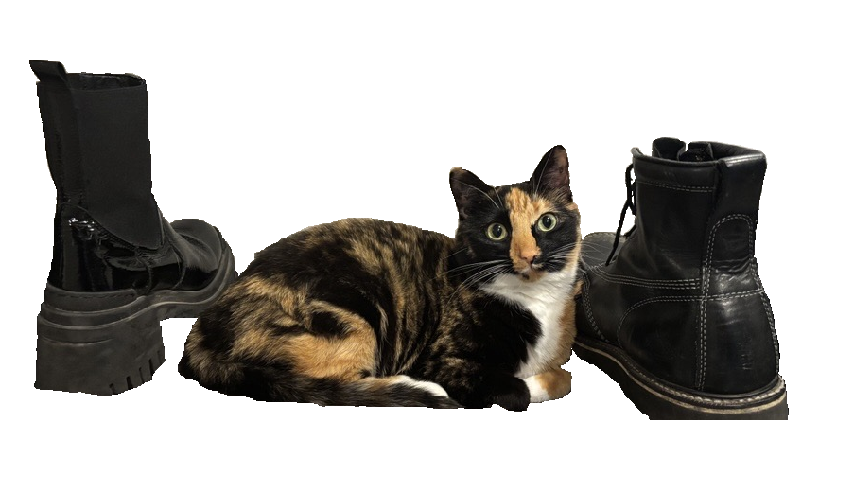
Workshop: Ideate
PART 2
15 MINUTES
GAME | ACTION / IDEA | MECHANIC
Cats in the City | Cats are chaotic and sometimes do crazy things that hurt them, but also help them | A “chaos roll” can help or hurt the cat, and they don’t know when it’s going to happen
Road Trippin’ | On a road trip and you have to hold in pee, getting increasingly desperate for a bathroom | A “pee meter” that goes up periodically, which makes other rolls worse
Astronomers | Discover planets no one has ever seen before and observe their attributes | Compare a card from a deck to a table: e.g. all “7s” are considered “extremely hot” planets.
Do you copy? | A limited amount of time to talk to a planet across the galaxy | The number on a timer counting down when a decision is made is the number that’s “rolled”
10 Candles | Telling a scary story at night, that is still slightly hopeful, but always in the brink of disaster | When literal, actual candles on the table are blown out, players lose something important regardless of how it was blown out.
What info helps determine outcomes? Is randomness involved?
Worksheets & slides here: tinyurl.com/CreateYourOwnOnePageRPG
Notes:
<nina>
And on this slide, we’ve got some more sample mechanics here. In Cats in the City, for example, the DM can simulate the chaos of real cats by asking players to roll a die which might hurt or help them. Check out the other examples on the slide here if you need inspiration, and we’ll see you again in 15 minutes.

Slide 11
Prototype: Writing the Rules
CREATE YOUR OWN RPG
Keep it Simple, Silly!
Keep what's essential to the core idea, save the rest for later
Limited number
Aim for a single mechanic that is easy to teach.
Easy to calculate
Use one form of comparison: counting, summing, etc.
Notes:
Deepti
We've done a lot of brainstorming, now we're going to synthesize those ideas to make a playable one-page RPG.
While it can be tempting to keep all the cool ideas we've generated so far, our goal is to create a simple game that still conveys the themes of our world, so we need to <Click> Keep it Simple Silly!
We need to know what our game is fundamentally about before we can decide what rules or features are essential, so it helps to define the quick pitch or core idea of our game based on the brainstorming in previous sections. Is this an adventurous sci-fi game about being crew members on a spaceship, like in Lasers & Feelings? Or a micro RPG about being an astronomer, or on a road trip, or being cats in the big city?
As we're sifting through our ideas, we can use this core idea as a guiding star to help us keep only what's essential for a first draft and save the rest for a later date. Keep content that help players feel more immersed in the world described by your pitch, or help them set up faster like encounter tables or example adventures. Everything else can be added in a later draft or even left for the players to define in game! For instance, in the Cats in the City RPG, I don't need to provide a map of the actual city because the players can build that themselves. Instead, I could provide a short encounter table that describes some of the people, animals, or places they might see to give them story inspiration.
In the spirit of Keeping it Simple, <CLICK> our prototype only needs one or two simple mechanics to help players navigate the world. Once again, we can use our core idea or pitch to decide on a core mechanic that determines the outcome of player's decisions, and then maybe add one or two more rules that contribute to player immersion in some way. The purpose of these mechanics should be to make it easier for the players to build the world and story, so we can keep our rules simple while also being creative. For example, in the horror roleplaying game Dread, they provide a character questionnaire for players and build tangible anxiety into the core mechanic by having player outcomes determined by pulling blocks from a Jenga tower, where bad things happen once the tower falls and every choice draws the players closer to that inevitability. The rest of play can be left to the rule of cool while the small ruleset keeps the game grounded to the dreadful themes of the world.
When we do need to add multiple rules to our game, <CLICK> we can still simplify them by having them use a single type of comparison or logical operator. If your core mechanic is to use dice to roll over a certain number to succeed, then you don't need to add a mechanic to roll under a number, sum up the totals of dice, etc. Because it makes it harder for players to understand what a "good" roll and "bad" roll looks like. Convoluted rules can be a barrier to immersion, no one wants to break character for a rules calculation or clarification. So it's best to keep things concise so that players can add their own complications to the game. <CLICK>

Slide 12
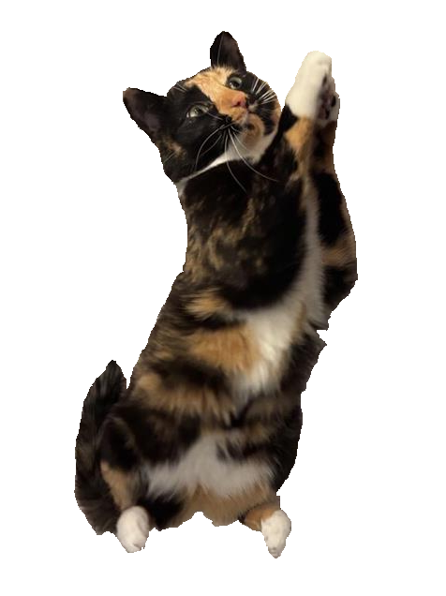
Workshop: Prototype
PART 3 (BOTH SIDES)
15 MINUTES
Describe your game and its core mechanic
Define how the game starts, what happens on a player's turn, the game’s loop, etc.
Tips:
  Use your work in Part 1 and 2 to fill out these sections
  Consider adding quick ways to make an adventure, like providing example adventures or tables to randomly generate a story
Worksheets & slides here: tinyurl.com/CreateYourOwnOnePageRPG
Notes:
Deepti
So with all that in mind, let's build a prototype! We'll give you 15 minutes to describe your game and how to play it, once again feel free to ping one of us if you need help or have a question.

Slide 13



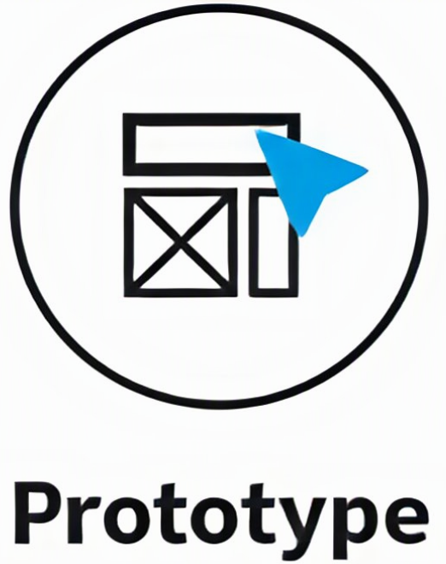

Design thinking
Design thinking is a way to create anything, work on any project, in a way that is human-centered at its core and favors progress over perfection
Learn about users through testing
Empathy helps define problems
Tests create new ideas for projects
Prototype sparks a new idea
Tests reveal insights that redefine the problem
Interaction Design Foundation
Interaction-design.org
Notes:
deepti
It might not have felt like it as you were making the game, but everyone here just used Design Thinking to make an RPG!
<CLICK> Design thinking was originally adapted for business purposes by the design consultancy IDEO and its founder Tim Brown.
They used it as a way to understand business needs and challenges and find solutions to problems in a way that’s human-centered at its core and favors progress over perfection. ​The trick in design thinking is to get into the shoes of the customer, to understand what they want and empathize with them in every step of the design process.
It allows us to build robust solutions by having us iterate through multiple stages of <CLICK> empathizing with our audience, (which you did when we picked a topic and described how we wanted our players to experience it) <CLICK>defining our problem space (which you did by defining what things and actions should be included in our game's world), <CLICK>generating ideas for solutions (which you also did by turning all those actions into game mechanics), <CLICK>prototyping the best ideas (which you should have right in front of you), <CLICK> and testing these prototypes to gather feedback that we can integrate into our next iteration (which we'll talk about soon). <Click> Frequently development in one stage can lead to updates in any or all stages regardless of order, <CLICK> and the design thinking framework encourages us to bounce between these stages regardless of order so that we can maintain creative freedom while keeping our ideas organized.<Click>
We tie all the work we've done to abstract design thinking principles.
Emphasize that Design Thinking is an iterative process, we've only helped them with the first iteration of their game but they can repeat these steps to improve their game
This is why we emphasized that nothing needs to be perfect, Design Thinking favors progress over perfection

Slide 14
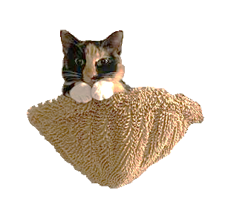

What to do with your game
Playtesting
Observe silently (without playing)
Ask them to think out loud
Everything’s up to interpretation
Publishing
DMs Guild, DrivethruRPG, Roll20
Itch.io
GitHub, your own personal website
Local game and book shops
Notes:
<nina> And now that each of you has an amazing RPG on your hands, what will you do next?
The first thing you should consider is playtesting <click>. Get a group of friends or other conference goers, and ask them to play your game so you can observe. Take silent notes, and don't talk to the players while they're playing. <click> And ask players to think out loud so you know what’s going on in their heads.
You can adjust your wording afterwards so it's closer to what you want people to read, but <click> roleplaying games are generally up to interpretation. Some people may even come up with amazing ideas you didn't think about!
After you've playtested, consider <click> publishing your game. Site like the DMs Guild, Drivethru RPG, and Roll20 are open marketplaces specifically for RPGs where you could put up your game for others to find, play, and even pay you. Similarly, <click> Itch.io is a website that is commonly known as an indie video game platform, but it also hosts a significant amount of RPGs, and there are frequent onepage RPG jams you can participate in to write an RPG in a short amount of time (but longer than this workshop). But when you use any marketplace, I recommend reading up on their policies before setting up shop so you understand how they function. You could also host your game on Github as a free Github Page, or on your own personal website.
You might also have a <click> local game or book store that would be willing to sell or give away copies of your game. And you can playtest there too!
Regardless of where and how you publish, your game should be accessible online or for ordering physical copies, payment should be simple (if you’re looking to get paid), and players should know where to find more of your games.

Slide 15
Thanks | Q&A
Download slides here: tinyurl.com/CreateYourOwnOnePageRPG
RPG from the talk | Why it was mentioned
Dungeons & Dragons | Common TTRPG people know; played in Stranger Things and Big Bang Theory
Lasers & Feelings | Well designed one-page RPG
Cats in the City | RPG created by Deepti using this workshop’s format; includes “chaos” mechanic
Ten Candles | “Candle” mechanic where real, lit candles impact gameplay
The Quiet Year | No Game Master, and players can make decisions that cause “grudges”
Everybody’s John | Bidding mechanic to “gain control” of the story
Road Trippin’ | “Pee meter” that impacts game play (designed by nina)
Astronomers | Drawing cards to simulate discovering planets (designed by nina)
Alice is Missing | Completely silent; No game master; players must text each other
Dread | Horror style game where a game of Jenga is used for tension
Caravan | Junk-based card game inside Fallout: New Vegas where you can only play cards you find
Notes:
<nina>
And that’s all we’ve got for you! We’ll leave you with a list of all the games we talked about during this talk, and if anyone has any questions we're more than happy to answer them. We hope that you’re inspired to continue working on this game, play it with your friends, and continue design thinking throughout your day.

Slide 16
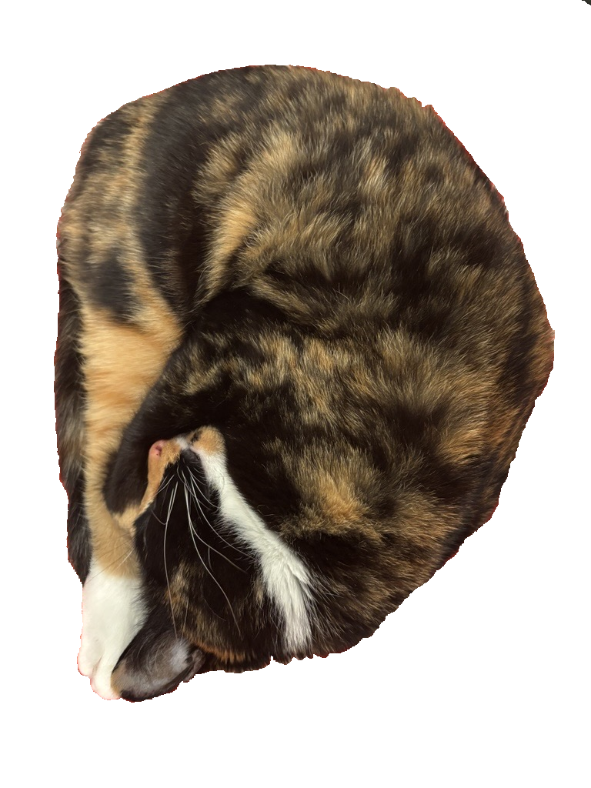

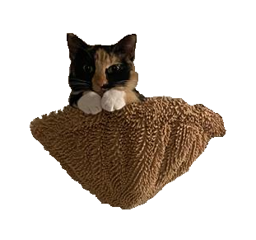
Cat/Fig Pics

